Slide 1
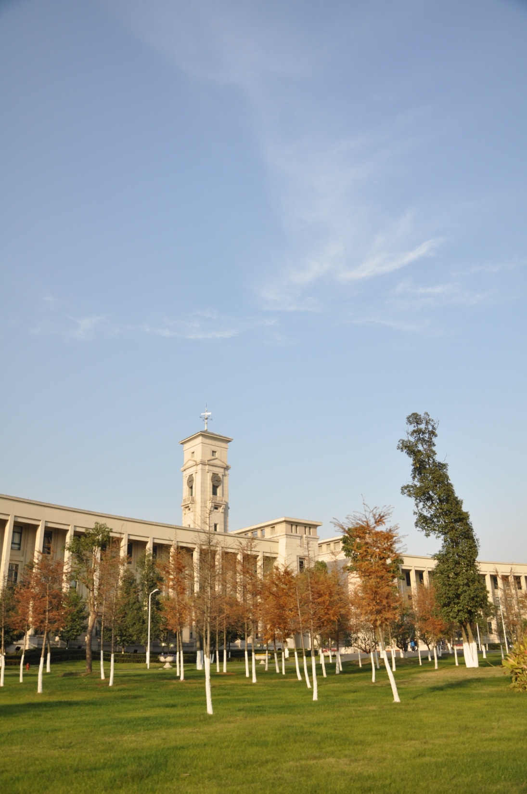

Learning Community Fora (LCF) in the Faculty of Science and Engineering

Slide 2
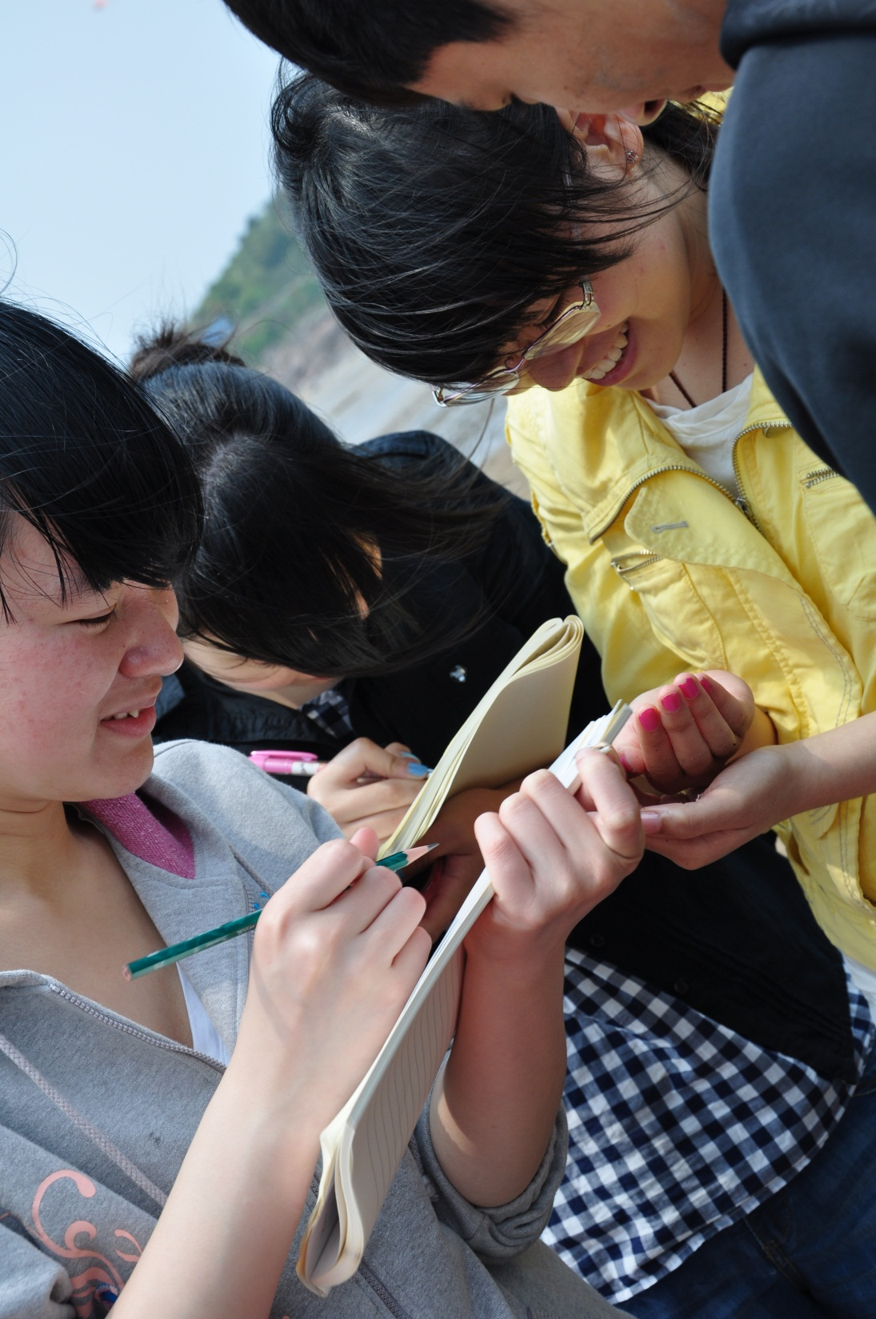
The purposes of the LCF are to ensure :
• the views of students are given proper weight in the processes of course and module review
• to ensure that the concerns of students about their courses of study are represented to the academic staff throughout the academic year
University of Nottingham Quality Manual

Slide 3
Student LCF representatives consult their student colleagues
The LCF Process
LCF administrator compiles the list and sends it to the LCF staff representatives
Student LCF representatives send a list of issues to the LCF administrator
LCF Meeting
(staff & student representatives)
LCF staff representatives contact the relevant members of staff for comments
Action points and minutes of the LCF Meeting are agreed amongst the LCF staff and student representatives
The LCF minutes are emailed to all staff and students. Action points are addressed and reviewed at the next meeting.

Slide 4
Members of the CS LCF
Programme Title | Staff Representatives | Student Representatives
BSc Computer Science | Paul Dempster | Y2 (2+2 / 1+2) x2 Y2 (4+0 / 3+0) x2 Y3 (4+0 / 3+0) x2 Y4 (4+0 / 3+0) x2
BSc Computer Science and Management
 |  | Y2 (2+2 / 1+2) x2 Y2 (4+0 / 3+0) x2 Y3 (4+0 / 3+0) x2 Y4 (4+0 / 3+0) x2
BSc Computer Science with Artificial Intelligence |  | Y2 (2+2 / 1+2) x2
BSc Software Engineering |  | Y2 (2+2 / 1+2) x2
Plus the LCF Administrator Ms Kelly Fu (Kelly.Fu@nottingham.edu.cn)

Slide 5
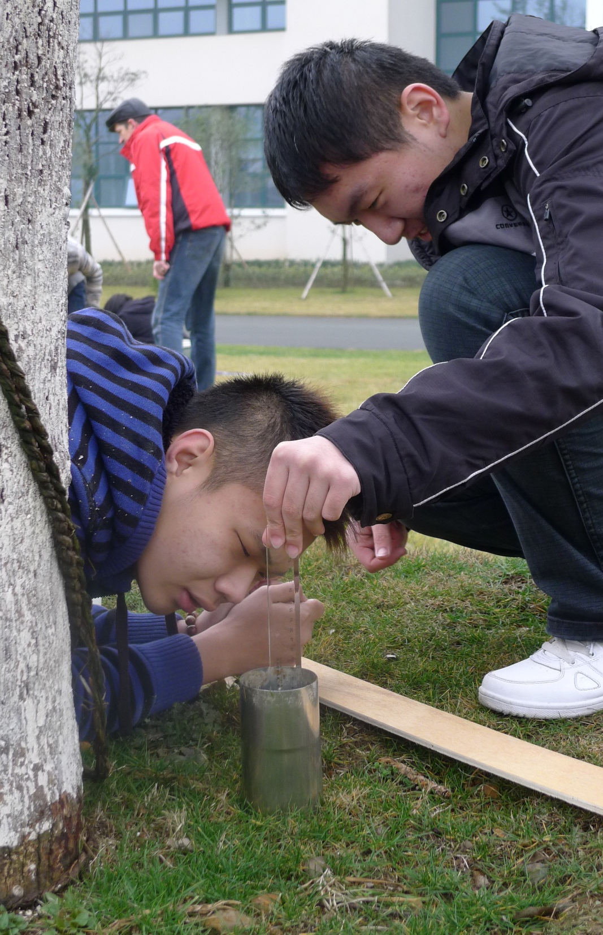
Student LCF Representatives
• You will be given 10 minutes at the end of this presentation to decide amongst yourselves who will be the LCF representative(s) for your degree programme for your year. Up to two representatives per year and per programme are allowed.
• Please give the name, student number and email address of your LCF representative(s) to your teacher at the end of this lecture.

Slide 6
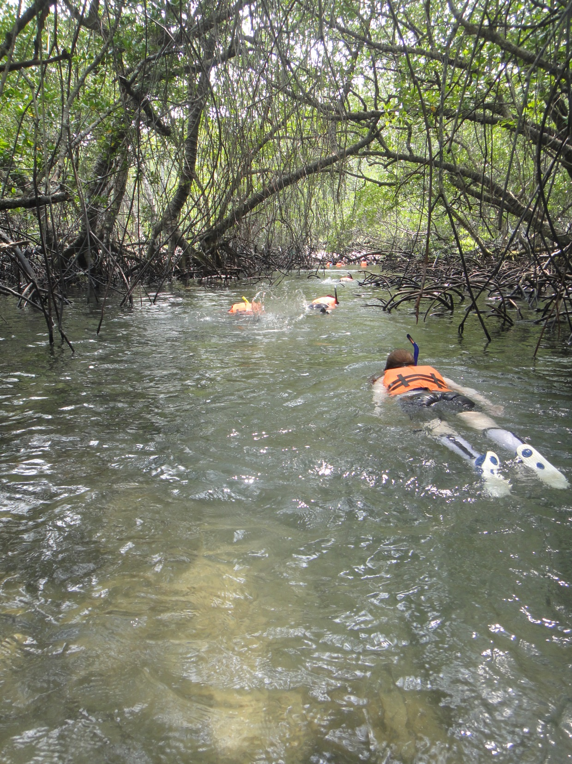
Student Union Education Network
The Education Network will provide training to all student LCF representatives
how to deal with issues and complaints professionally
how to report the issues to the LCF clearly and concisely
Training (exact dates to be confirmed):
7-9 October 2015
22-26 February 2016

Slide 7
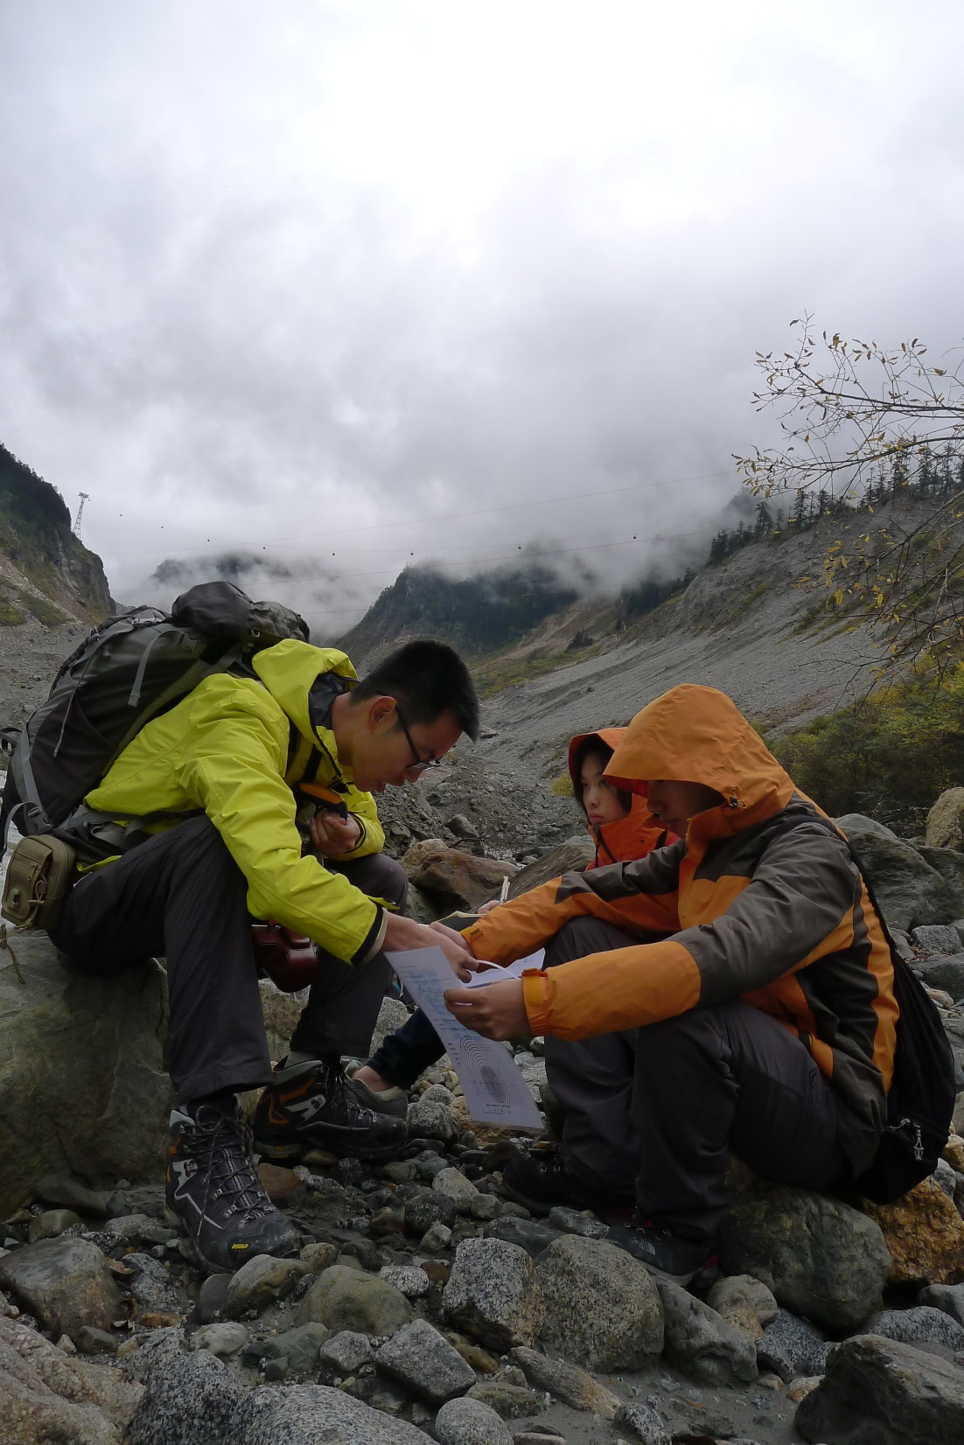
LCF Nottingham Advantage Award (NAA) Module
An LCF NAA module will run for the first time this year. It will only be available to LCF representatives.
It aims to provide an opportunity for students to develop a broad range of transferable skills and learn how to work in partnership with other students and academic staff.
Sign up at the NAA Fair (Wednesday 16th September )

Slide 8
Responsibilities of the Student LCF Representatives
• To liaise with all students within their year and degree programme to ensure that any issues that students wish to raise are placed on the agenda.
This can be done via email, online survey, questionnaires or if preferred, permission may be sought through the LCF staff representative to hold a short student consultation session during a lecture. Staff will not be present during these consultations.
• To ensure that the views of students are presented fairly and anonymously at LCF meetings.
• To ensure a fair, open and transparent LCF process.

Slide 9
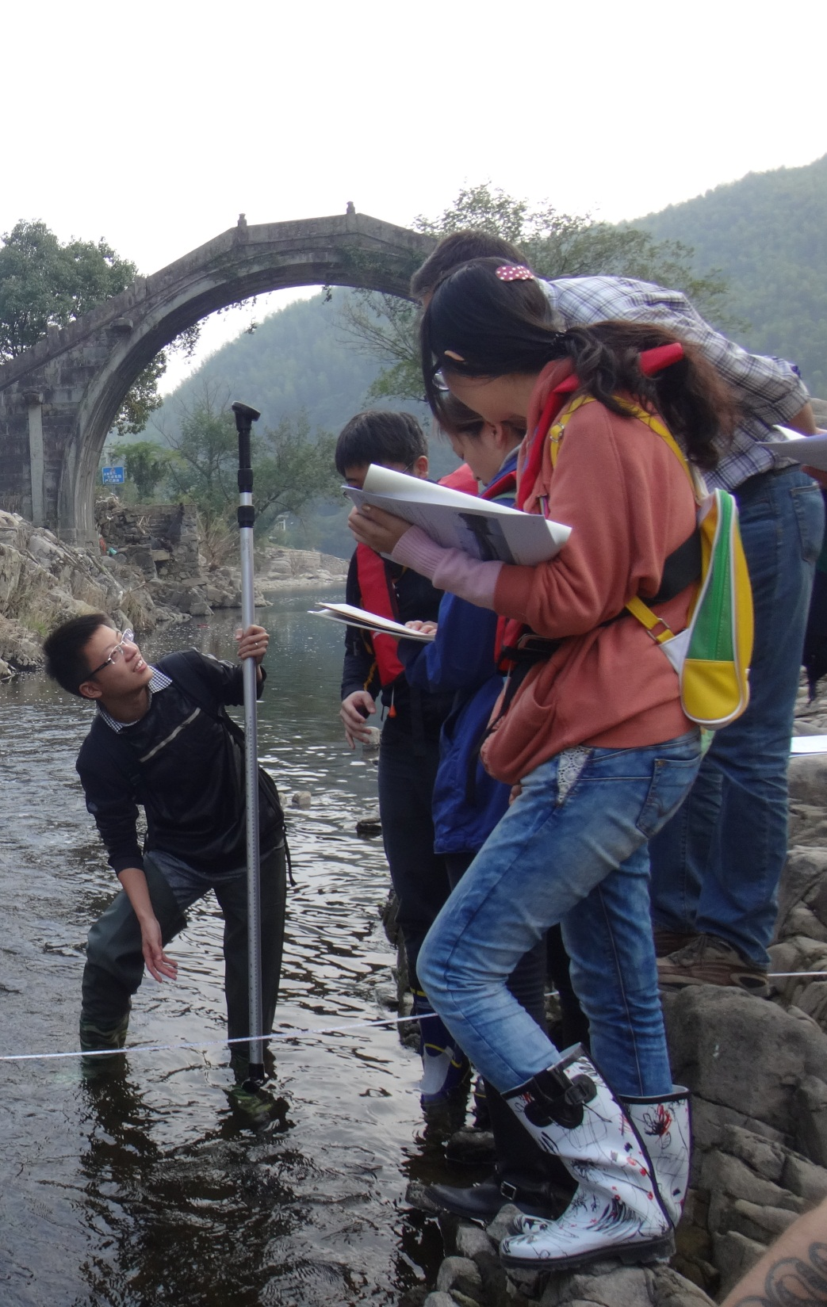
Benefits of being the Student LCF Representative
• Excellent experience
• Evidence that you are a trusted and responsible individual
• Award certificate
• Support the improvement of academic teaching and learning at UNNC
• Learn how to communicate effectively with tutors and students
• Opportunity to obtain an NAA

Slide 10

Meetings
There will be two meetings per year (one in Semester 1 and one in Semester 2).
Semester 1 2015/16
• Weeks starting 12 & 23 October 2015 (Deadline for submission of issues is FIVE days before the meeting)
Semester 2 2015/16
• Weeks starting 29 February & 11 March 2015 (Deadline for submission of issues is FIVE days before the meeting)

Slide 11
What next?
We would like to have two student LCF representatives from each degree programme from each year.
Can you decide amongst yourselves now who you would like to represent your class?
Your teacher will be collecting this information at the end of the break. Can you provide them with following information about your representatives please:
• Name
• ID number
• Degree programme
• Year of study
• Email address
• Gender

Slide 12
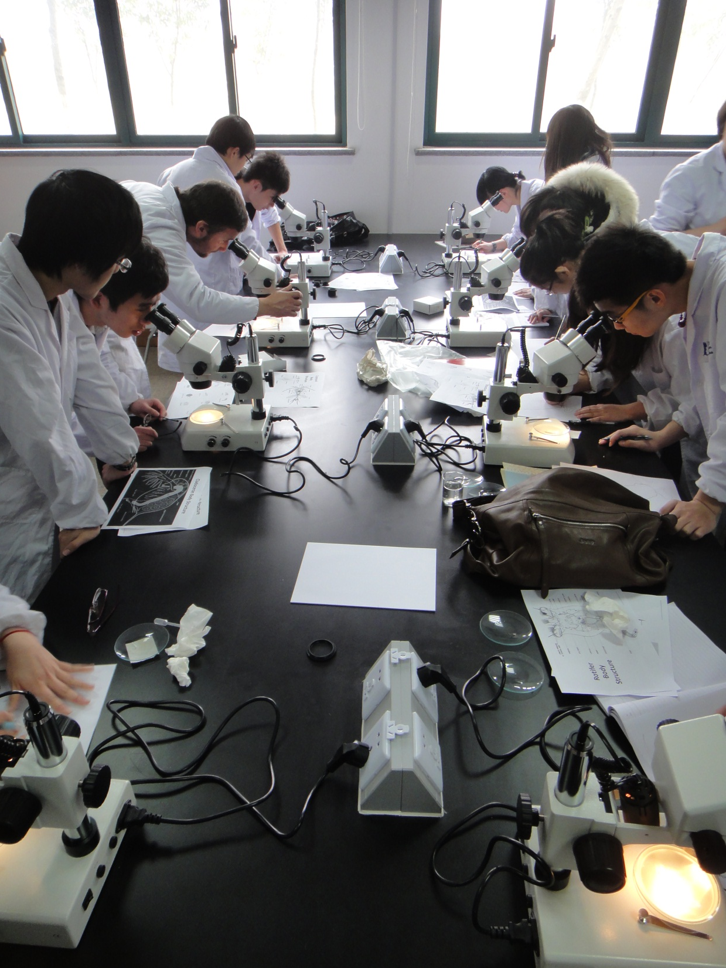
Further Information
Student Handbook
LCF Noticeboard (outside SEB416)
Your staff departmental LCF representatives
Contact:
Student Union LCF Coordinator:
Manqi LIN (6516534) zy16534@nottingham.edu.cn
FoSE Staff LCF Coordinator:
Odette Paramor
(Odette.Paramor@nottingham.edu.cn)

